Slide 1
SURVEYPRO

Slide 2
Table of contents
01
02
03
04
Project Proposal
Requirements
You can describe the topic of the section here
You can describe the topic of the section here
05
Prototyping
Evaluation
Designing Alternatives
You can describe the topic of the section here
You can describe the topic of the section here
You can describe the topic of the section here

Slide 3
01
Project Proposal
A clearly stated project proposal forms the basis of SurveyPro. We saw the need for an online survey platform that serves a range of user groups, including researchers, businesses, and educators. This phase required defining our target consumers, setting specific usability and UX objectives, and explaining why it was important to develop a user-centered survey platform.

Slide 4
Goals & Target Users
Usability Goals:
Easy Navigation
Accessibilty
User-friendly Interface
Effectivess
User Experience Goals:
Ease of Use
Fun
Overall Satisfaction
Target Users:
Researchers
Businesses
Educators
And, people who rely on robust survey tools for data collection and analysis

Slide 5
02
Requirements
The next phase of the process was the requirements phase, in which we developed thorough personas for the most important user groups. These personas gave insightful information about user wants and preferences. We used storyboards to visualize user experiences and interactions, providing a user-centric design approach. Additionally, we gathered user data through questionnaires, interviews, and surveys, and we rigorously analyzed the results to draw out important trends and insights. This data-driven strategy influenced our design choices and provided the framework for SurveyPro's growth.

Slide 6
Functional Requirements & Environmental Requirements
Functional Requirements:
User Account Creation and Management
Mobile Compatibility
Reporting and Analytics
Creation and Management of Surveys
Environmental Requirements:
Scalability
Reliability
Accessibility

Slide 7
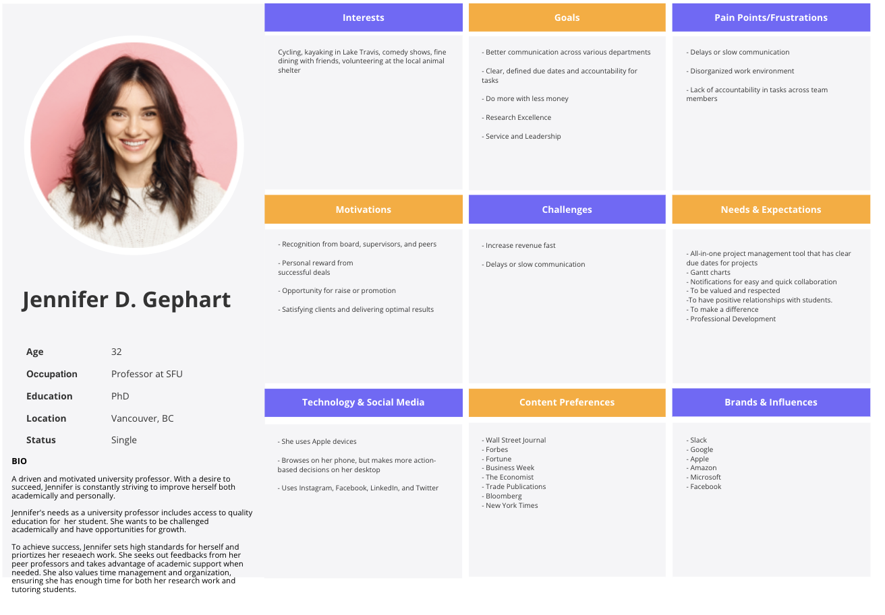
Persona

Slide 8
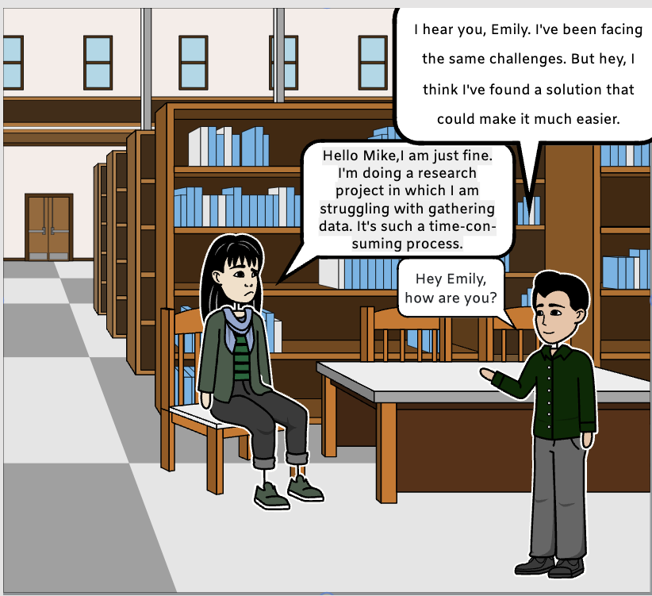
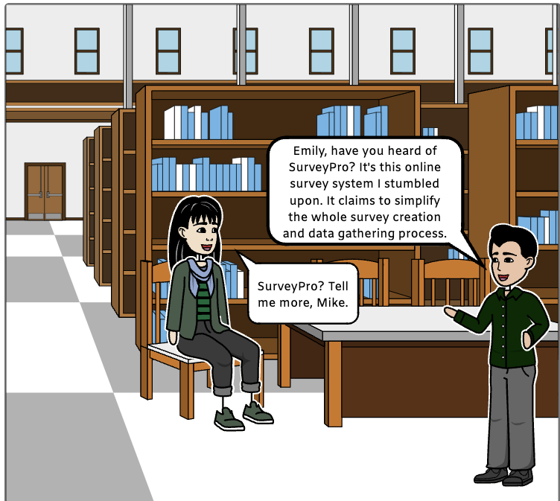
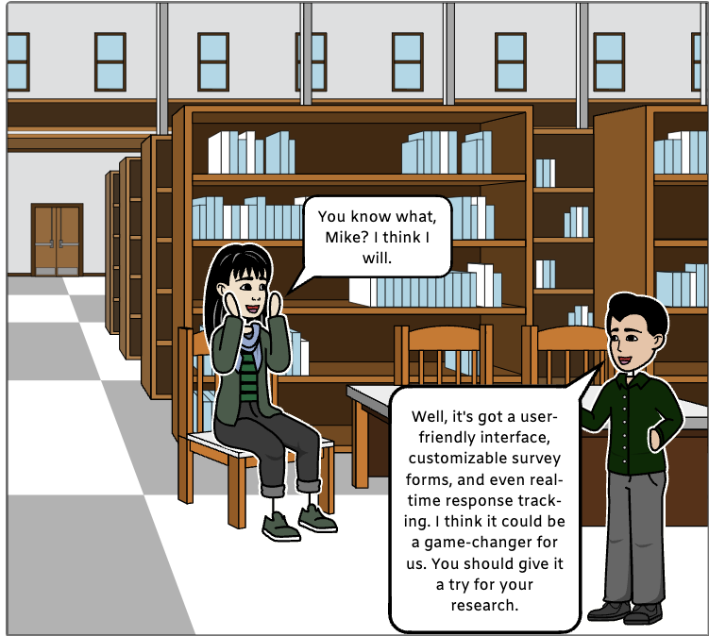
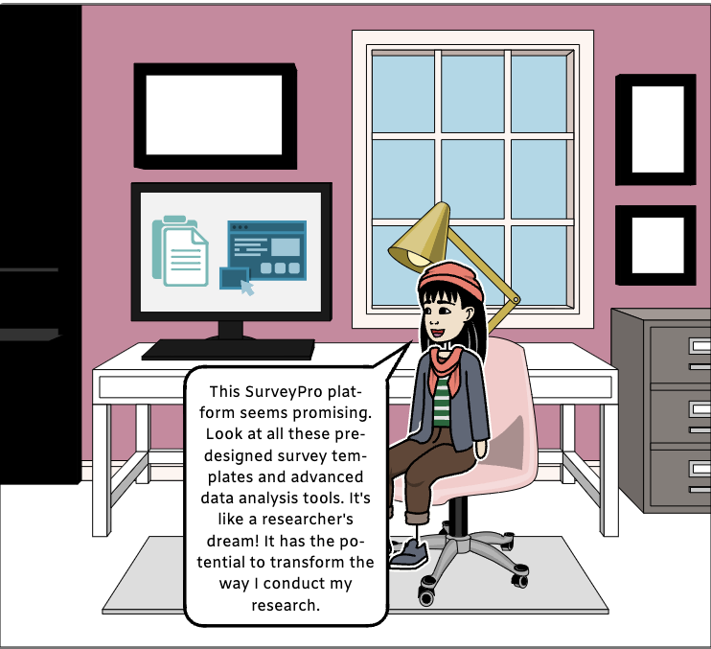
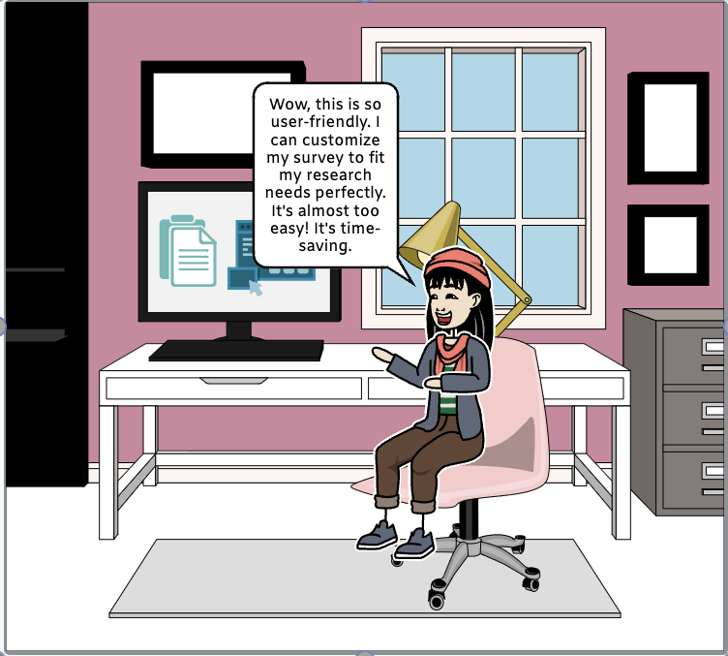
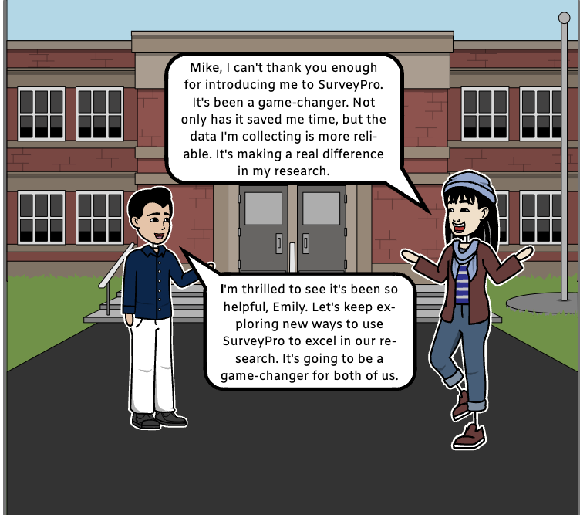
Storyboard

Slide 9
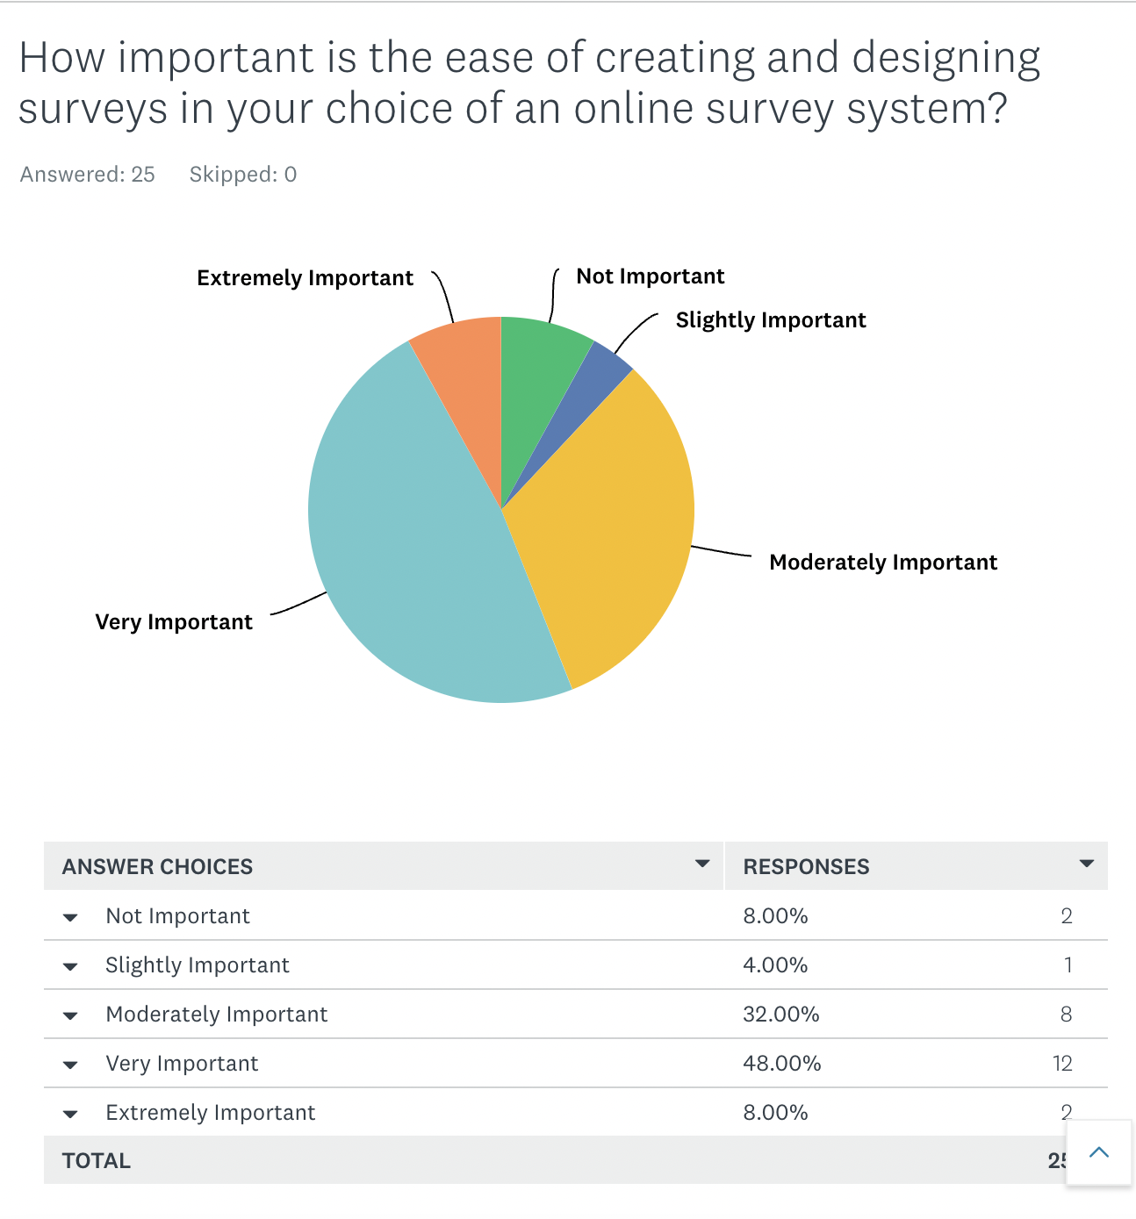
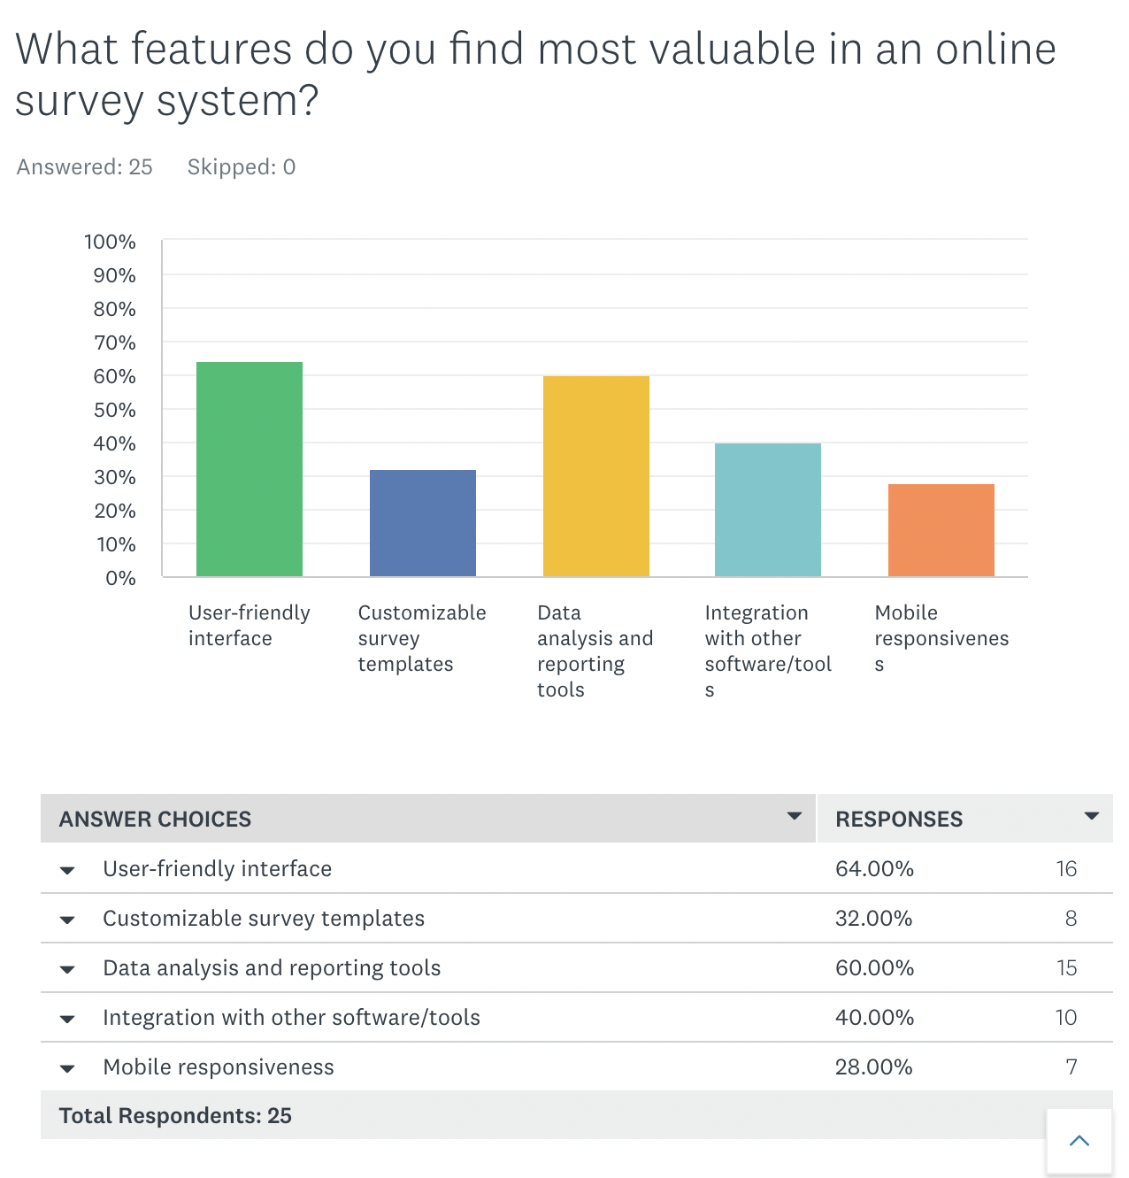
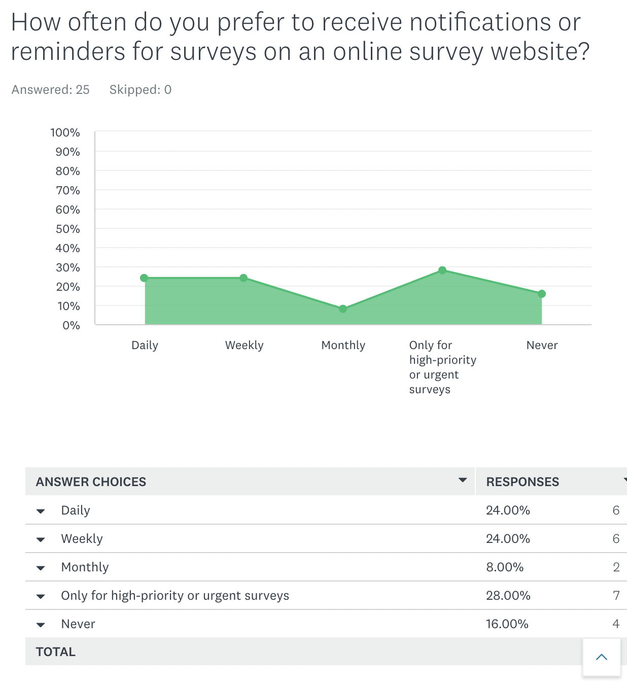
Data Gathering

Slide 10
03
Designing Alternatives
Every UX project must include a crucial phase called designing alternatives, and SurveyPro was no different. Starting with low-fidelity prototypes, we investigated a wide range of design ideas and options. We brainstormed and iterated through various design options using sketches and design visualizations, ensuring that our final design would be both user-friendly and effective.

Slide 11
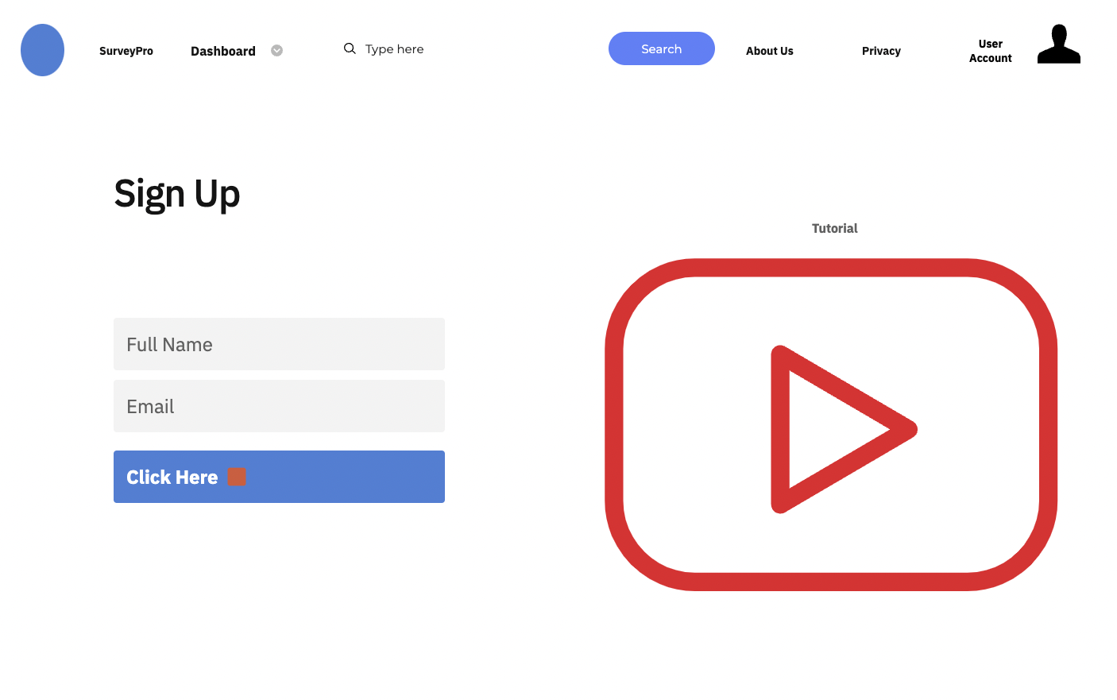
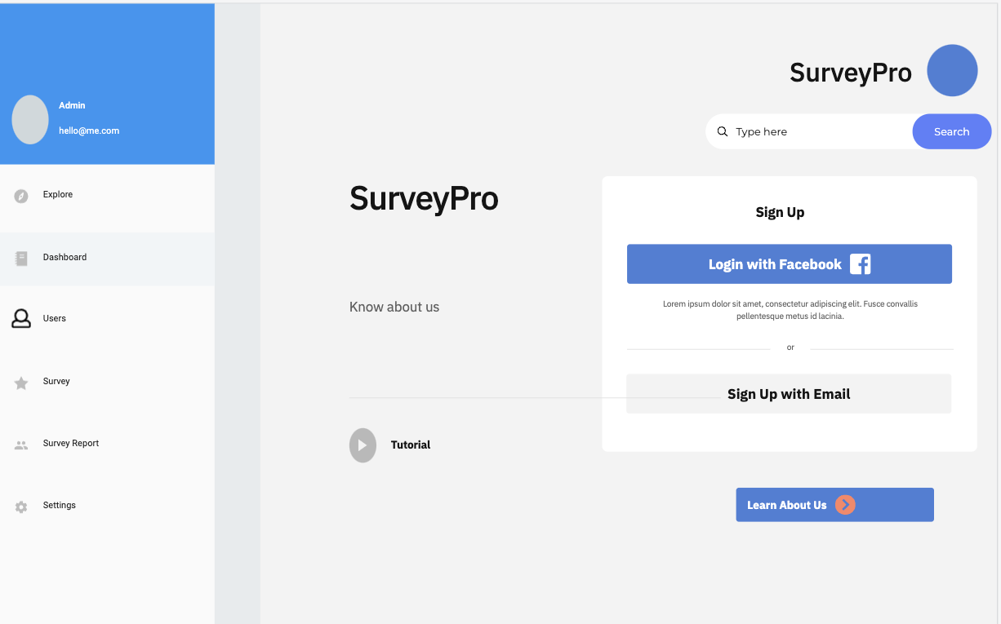
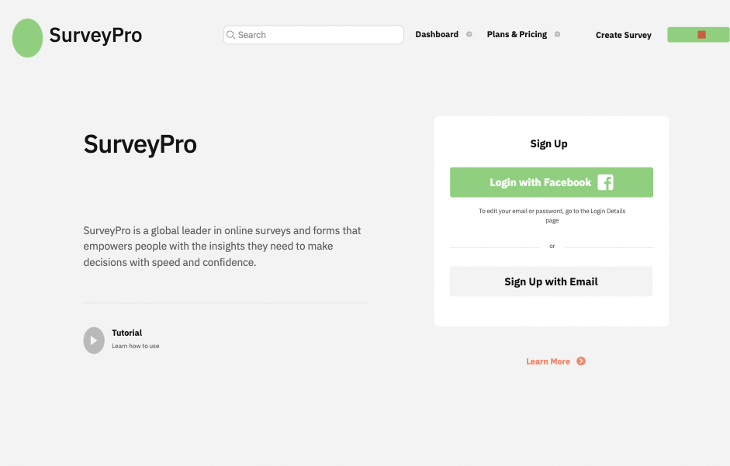
03
Designing Alternatives

Slide 12
04
PROTOTYPING
In this phase, we transitioned from low-fidelity concepts to high-fidelity prototypes during the prototyping phase. Users can virtually explore the functionality and user interface of SurveyPro through these high-fidelity prototypes. We realized our concept by utilizing cutting-edge design and development tools. This phase wasn't without difficulties, which we skillfully overcame to accomplish our prototype objectives.

Slide 13
Low- Fidelity And High – Fidelity Prototype
Low - Fidelity:
It was on Proto.io
Made UI in a way more attractive and intuitive
High - Fidelity:
It was developed using PHP, HTML, CSS, Javascript, Jquery, and MySql.

Slide 14
Challenges
Performance and Scalability: Meeting the demand for fast loading times and efficient operation, capable of handling a growing user base, through performance optimization and scalable hosting solutions.
Accessibility Challenge: Ensuring an inclusive user experience for individuals with disabilities by adhering to accessibility standards

Slide 15
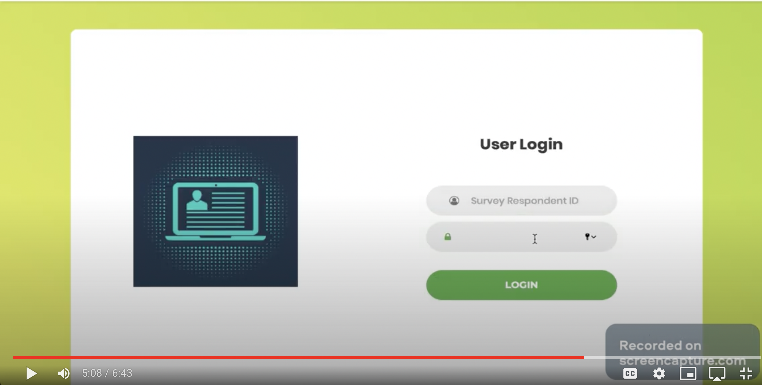
SurveyPro Recording
LINK: https://drive.google.com/file/d/1_F1BDiDFcxek77mKz7lXpymhHz9MENbZ/view?usp=sharing

Slide 16
05
Evaluation
The evaluation phase in SurveyPro's development is crucial. Our evaluation process included both extensive user feedback gathering and usability testing. With the help of this thorough evaluation, we were able to learn a lot about the performance of the prototype, identify its advantages, and pinpoint its weaknesses. We made sure that SurveyPro perfectly satisfies user expectations and usability objectives by carefully analyzing user interactions, feedback, and usability data.

Slide 17
Methods for Usability Testing
Video Testing Method for some of our users
Offline Usability Testing Method for some of the other users who participated.
We observed behaviors of our participants, their interactions and reactions in real-time as part of the Usability Testing Method
We also made a close observation on evaluators who had identified potential issues that arose during real-time usage of the application.

Slide 18
Improvements Based On Feedbacks
Drop Down Menu for Choosing Survey to view info and add extra survey respondents
Consistent Font Style Throughout the website to boost professionalism
Adding a Search field in the survey questions section to improve visibility and functionality
To improve, website security and user experience, a way to hide tabs for users who are not logged in should be implemented.

Slide 19
Thank You

